Slide 1


Slide 2
React JS
(Create-React-App)
Lecture-15

Slide 3
Today’s Agenda
Understanding The React App Structure
Difference between package.json and package-lock.json
Modify the default React App

Slide 4


React App Structure
The Create React App utility generates the basic structure of our App by creating some very useful files and folders
To be very precise it generates , 3 folders and 18 files by default

Slide 5
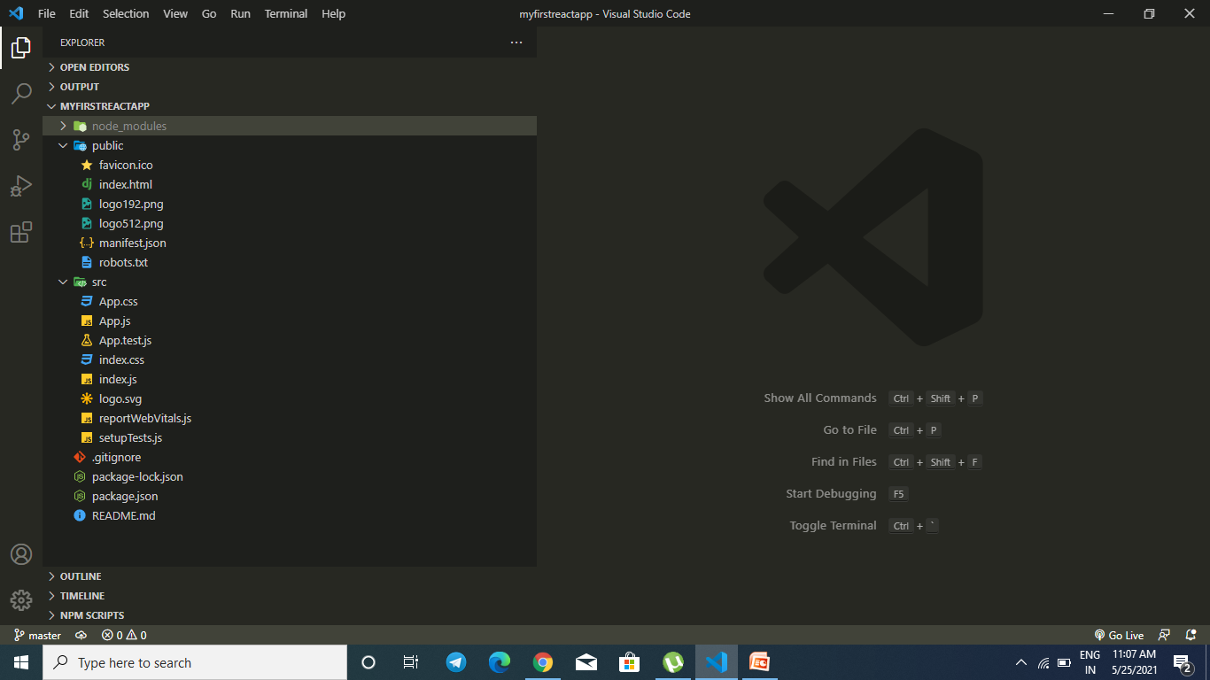
React App Structure
To view them we can open the myfirstreactapp using vscode editor and see its structure

Slide 6
What Is WebPack ?
WebPack is a powerful module bundler for JavaScript applications.
It packages all the modules in our application into one or more bundles (often, just one) and serves it to the browser.

Slide 7
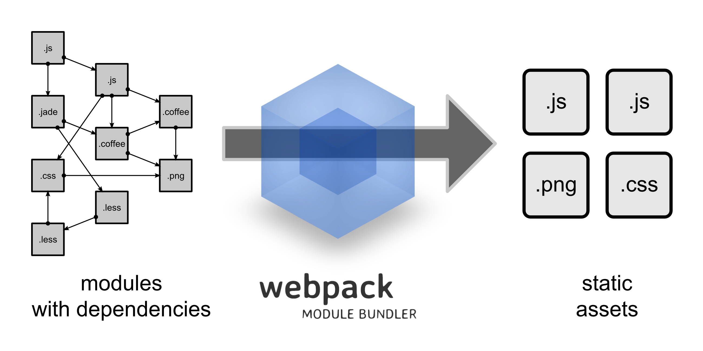
What Is WebPack ?

Slide 8
What Is WebPack ?
However, Webpack is more than just a module bundler.
It can also can transform, minify and optimize all types of files before serving them as one bundle to the browser.

Slide 9
React App Structure
Let’s understand the role of each file:
node_modules:
This directory contains dependencies and sub-dependencies of packages used by the current React app, as specified by package.json.
public folder and it’s files:
This directory contains assets that will be served directly without additional processing by webpack.

Slide 10
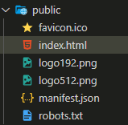
React App Structure
Index.html
It is the template file
which is served up when
we run start script to
launch our app.
manifest.json
The manifest file
configures how our we
app will behave if it is
added to an Android
user’s home screen
robots.txt
Defines rules for spiders,
crawlers and scrapers
for accessing our app.

Slide 11
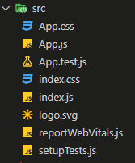
React App Structure
Src folder and it’s files: This contains the JavaScript files that will be processed by webpack and is the heart of the React app.
Contains styles of our
react component (App.js)
This is the test file for our
component App.js
This file has very basic react
component defined which can
be replaced by our own root
component
Contains styles for general setup of our app.
WebVitals are a set of useful
metrics that aim to capture the
user experience of a web page.
index.js file is used for routing
or calling our component which
gets rendered. Do not change
any other name else
compilation will get failed
As the name suggest this files
setups tests and runs them.

Slide 12
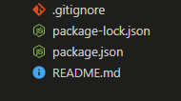
React App Structure
Root folder files:
This is the standard file used
by the source control tool git to
determine which files and
directories to ignore when
committing code.
This file contains the exact
Dependency tree installed in node
modules/. This provides a way for
teams working on private apps to
ensure that they have the same
version of dependencies and sub-dependencies.
This file contains various
metadata that is relevant to
our project. It contains information
about our project (name, version, etc)
as well as all the dependencies
This file can be used to
define usage, build instructions,
summary of project, etc. It uses
markdown markup language to
create content.

Slide 13
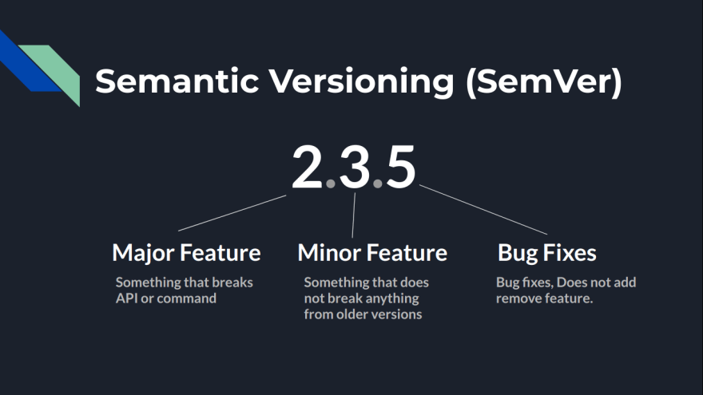
Semantic Versioning

Slide 14
Semantic Versioning
Bug fix/patch version
Includes bug fixes/documentation spelling mistakes etc.
Minor version
Includes additions of functions or API which does not break anything from the older versions So anything that runs on v1.1.0 should work on v1.9.0 as well.
Major version
Includes version which breaks stuff. It can include removing APIs or changing names of functions so anything that works on v1.0.0 may not necessarily work on v2.0.0

Slide 15
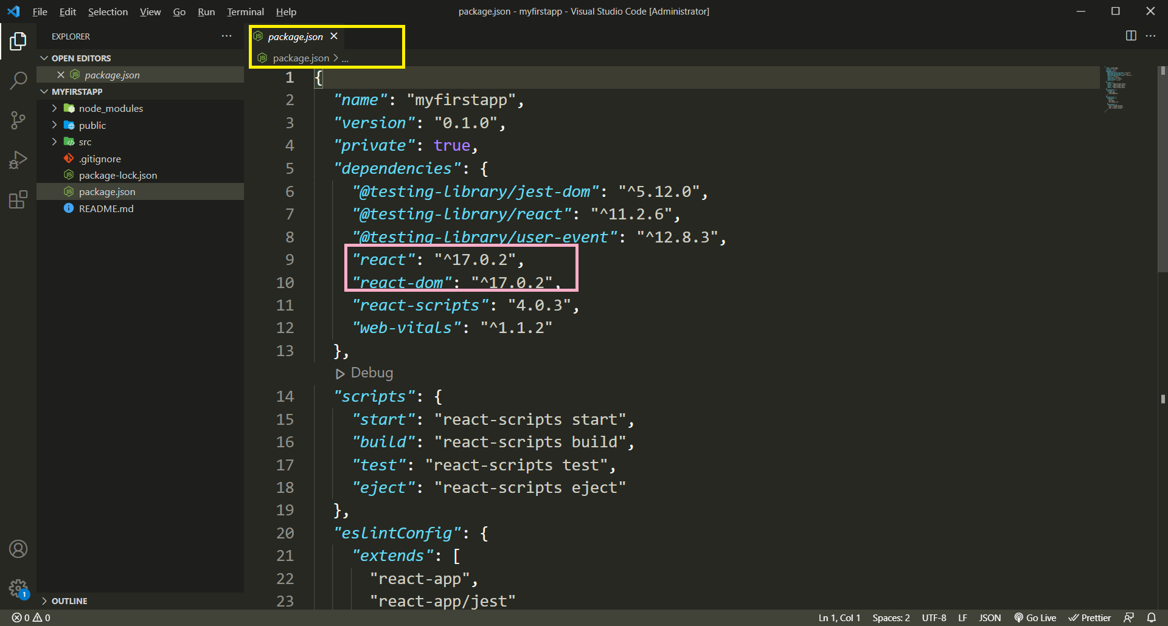
The package.json File
As previously mentioned , package.json is a file that contains information about our project (name, version, etc) and it lists the packages that our project is dependent on.

Slide 16
The package.json File
So as you can see , after every dependency listed under package.json there's a number something like ^17.0.2 which is the version of that package .
But before the version, there is ^ and it can be a total destroyer for our project.

Slide 17
Why ^ Is Dangerous ?
^ sign before the version tells npm that if someone clones the project and runs npm install in the directory then install the latest minor version of the package in his node_modules.
So lets say we are having react with ^17.0.2 in package.json and then react team releases version 17.1.2 and now when someone clones our repo and runs npm install in that directory they will get the version 17.1.2

Slide 18
Why ^ Is Dangerous ?
This can sometimes cause issues since the developers on the same project might all be on different dependency versions.
So npm later released a new file called package-lock.json to avoid such scenarios

Slide 19
The package.json File
The file package-lock.json will simply avoid this general behavior of installing updated minor version .
So when someone clones our repo and runs npm install in their machine then npm will look into package-lock.json and install exact versions of the package as the owner has installed so it will ignore the ^ from package.json.

Slide 20
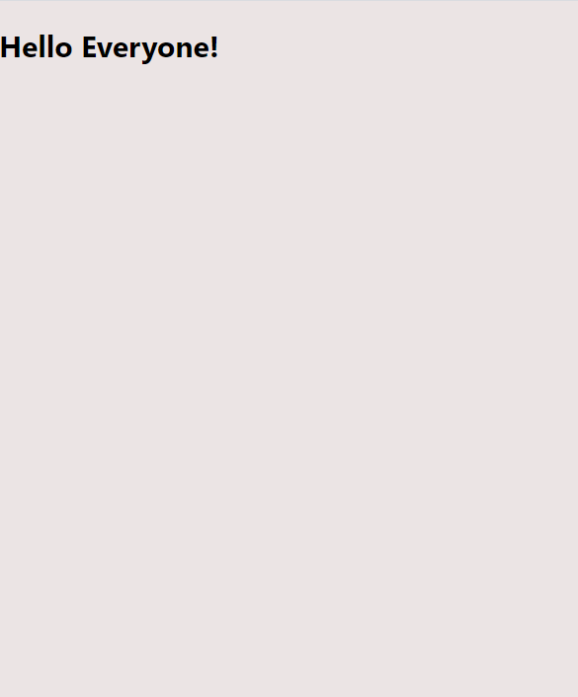
Modify The Default Structure And Output
Let us now change the default app output to the shown below:

Slide 21
Modify The Default Structure
The structure of this app is the default structure which is provided by the React to showing up the default React page.
let's delete those files which are not necessary at this learning level.
We will keep only those files that are important to compile and run our React app.

Slide 22
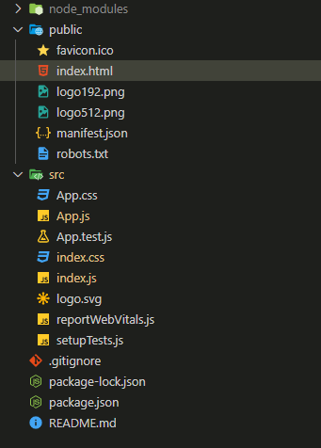
Modify The Default Structure
Delete These all the files

Slide 23
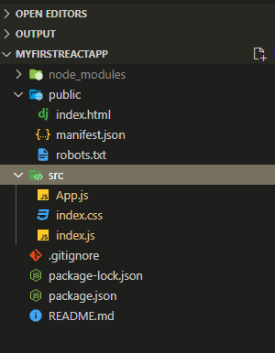
Modify The Default Structure
Now our structure looks as follows:

Slide 24
Modify The React Application
let's now have a look at our src folder because that is where we will spend the our majority of our time, that is where we will write our React code.
It contains 3 files 2 JavaScript file and another one is a CSS file:
App.js
index.js
index.css
In these 3 files, we will write React code which is just JavaScript code. so we are just going to write some JavaScript code and some special syntax introduced by React .

Slide 25
App.js
The App.js file contains default React code which is provided by React to showing up the default page of React.
Let's change this code and write our own code to show some text on the browser's screen.
App.js
function App() {
return (
<div>
<h2>Hello Everyone!</h2>
</div>
);
}
export default App;

Slide 26
App.js
The App.js is a main component of our app.
The App.js file holds a function named App
It’s return something which is HTML code inside our JavaScript code and this is a feature called JSX which is introduced by React.
In the previous lectures we have already covered that what is JSX?
After defining the function and we then export this function.
Because in modern JavaScript if we have something like a function or a class or an object defined in one file and we want to use it in another file we have to export and import it.

Slide 27
Index.js
Index.js
import ReactDOM from "react-dom/client";
import App from "./App";
import "./index.css";
let root = ReactDOM.createRoot(document.getElementById("root"));
root.render(<App />);

Slide 28
Index.js
In the first line the ReactDOM package is exporting some ReactDOM object and we’ re importing here into index.js
After that, we have imported our App.js and Index.css file into the index.js file.
Using this ReactDOM object we call the method createRoot() passing it the DOM object to be used as the root element
The createRoot() method returns us a root object an using this root object we have called the render() method
The render method takes our App component as argument and renders it on the root element

Slide 29
Index.html
Index.html
<!DOCTYPE html>
<html lang="en">
<head>
<meta charset="utf-8" />
<link rel="icon" href="%PUBLIC_URL%/favicon.ico" />
<meta name="viewport" content="width=device-width, initial-scale=1" />
<meta name="theme-color" content="#000000" />
<meta
name="description"
content="Web site created using create-react-app"
/>
<title>React App</title>
</head>
<body>
<noscript>You need to enable JavaScript to run this app.</noscript>
<div id="root"></div>
</body>
</html>

Slide 30
Index.js
index.css
body {
margin: 0;
font-family: -apple-system, BlinkMacSystemFont, "Segoe UI", "Roboto", "Oxygen",
"Ubuntu", "Cantarell", "Fira Sans", "Droid Sans", "Helvetica Neue",
sans-serif;
-webkit-font-smoothing: antialiased;
-moz-osx-font-smoothing: grayscale;
background-color: #ebe4e4;
}
code {
font-family: source-code-pro, Menlo, Monaco, Consolas, "Courier New",
monospace;
}
#root {
color: rgb(8, 9, 85);
}

Slide 31
Start The Development Server
Let’s start the development server by using “npm start” command

Slide 32
Creating Class Based Component In CRA
As we know , we can create components using classes also.
So now lets edit the previous app , by changing the function App() to class App.
This will require some important changes listed on the next slide

Slide 33
Creating Class Based Component In CRA
Create a js file called Hello.js
Import the class Component from the package react
Create a Hello component , which will return the message Hello Everyone
Export Hello
In the file App.js we will import Hello and Component classes
In the file App.js create a class based component called App and in its render() method render the Hello component
Finally render the App component from index.js

Slide 34
Index.js
Hello.js
import React,{ Component } from "react";
class Hello extends Component {
render() {
return <h2>Hello Everyone!</h2>;
}
}
export default Hello;

Slide 35
Index.js
App.js
import Hello from "./Hello";
import React,{ Component } from "react";
class App extends Component {
render() {
return (
<div>
<Hello />
</div>
);
}
}
export default App;

Slide 36
Index.js
index.css
body {
margin: 0;
font-family: -apple-system, BlinkMacSystemFont, "Segoe UI", "Roboto", "Oxygen",
"Ubuntu", "Cantarell", "Fira Sans", "Droid Sans", "Helvetica Neue",
sans-serif;
-webkit-font-smoothing: antialiased;
-moz-osx-font-smoothing: grayscale;
background-color: #ebe4e4;
}
code {
font-family: source-code-pro, Menlo, Monaco, Consolas, "Courier New",
monospace;
}
#root {
color: rgb(8, 9, 85);
}

Slide 37
Index.js
index.js
import ReactDOM from "react-dom/client";
import "./index.css";
import App from "./App";
let root = ReactDOM.createRoot(document.getElementById("root"));
root.render(<App />);

Slide 38
How requests process in the React?
Bowser
Index.html
Index.js
App.js

Slide 39
Thank You

